Slide 1


Microservices
Introduction
Design Principles and Design Patterns

Slide 3
Monolithic - Overview
The term monolithic applies to tightly integrated applications where it is hard to change one function without also recoding other parts of the application.
Components in a monolithic application might be distributed among many machines, but they remain highly dependent on one another.
Not only does the addition of a new feature have ripple effects throughout the code, but deploying the change requires retesting and redeploying the entire application.
These upgrades can be labor-intensive and hazardous, particularly when an application has hundreds of thousands or even millions of users.

Slide 4
Monolithic Application Architecture
The term "monolithic" comes from the Greek terms monos and lithos, together meaning a large stone block. The meaning in the context of IT for monolithic software architecture characterizes the uniformity, rigidity, and massiveness of the software architecture.
A monolithic code base framework is often written using a single programming language, and all business logic is contained in a single repository.

Slide 5
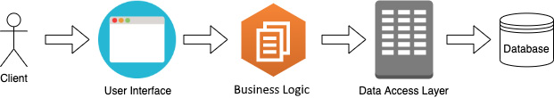
Monolithic Application Architecture
Typical monolithic applications consist of a single shared database, which can be accessed by different components. The various modules are used to solve each piece of business logic. But all business logic is wrapped up in a single API and is exposed to the frontend. The user interface (UI) of an application is used to access and preview backend data to the user. Here's a visual representation of the flow:

Slide 6
Monolithic Application Architecture
In this architecture, all the processes are tightly interconnected and run in a single service. This means that if you make a change in a single process, you may need to update the entire system. This approach is simple to develop and deploy and is excellent for small, simple applications.
An example of this might be a traditional eCommerce web application like an initial version of Amazon, where all functionalities like user interface, product catalog management, shopping cart, payment, and customer management are part of a single application. If a change is needed in one area, such as the payment system, the entire application must be tested and redeployed.

Slide 7
N-tier architecture in Monolithic Apps
The N-tier architecture allows developers to build applications on several levels. The simplest type of N-tier architecture is the one-tier architecture.
In this type of architecture, all programming logic, interfaces, and databases reside in a single computer.
As soon as developers understood the value of decoupling databases from an application, they invented the two-tier architecture, where databases were stored on a separate server.
This allowed developers to build applications that allow multiple clients to use a single database and provide distributed services over a network.

Slide 8
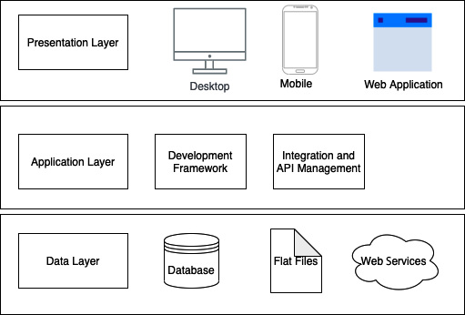
N-tier architecture in Monolithic Apps
Notes:
The topmost layer of the three-tier architecture is known as the presentation layer, which users directly interact with. This can be designed as a desktop application, a mobile application, or a web application. With the recent advancement of technology, desktop applications have been replaced with cloud applications. Computational power has moved from consumer devices onto the cloud platform with the recent growth of mobile and web technologies.
The three-tier architecture's middle layer is known as the application layer, in which all business logic falls. To implement this layer, general-purpose programming languages, along with supporting tools, are used. There are several programming languages with which you can implement business logic, such as Node.js, Java, and Python, along with several different libraries. These programming languages might be general-purpose programming languages such as Node.js and Java or domain-specific languages such as HTML, Apache Groovy, and Apache Synapse. Developers can use built-in tools such as API gateways, load balancers, and messaging brokers to develop an application, in addition to general-purpose programming languages.
The bottom layer is the data layer, which stores data that needs to be accessed by the application layer. This layer consists of databases, files, and third-party data storage services to read and write data. Databases usually consist of relational databases, which are used to store different entities in applications. There are multiple databases, such as MySQL, Oracle, MSSQL, and many more, used to build different applications. Other than using those databases, developers can select file-based and third-party storage services as well.

Slide 9


Monolithic Application Conceptual Model
Scripts/ Third Party Systems
User Interfaces
API endpoints
Web service
Presentation Layer
Application software Business Logic
Run time libraries
Database Engine
Table
Table
Table
Table
Table
Table
Table
Table
Table
Table
Table
Table
Table
Table
Table
Table

Slide 10
Service Oriented Architecture
Service-oriented architecture was largely created as a response to traditional, monolithic approaches to building applications.
SOA breaks up the components required for applications into separate service modules that communicate with one another to meet specific business objectives.
Each module is considerably smaller than a monolithic application, and can be deployed to serve different purposes in an enterprise. Additionally, SOA is delivered via the cloud and can include services for infrastructure, platforms, and applications.

Slide 11
Service Oriented Architecture
Each service in an SOA embodies the code and data required to execute a complete, discrete business function (e.g. checking a customer’s credit, calculating a monthly loan payment, or processing a mortgage application).
The service interfaces provide loose coupling, meaning they can be called with little or no knowledge of how the service is implemented underneath, reducing the dependencies between applications.

Slide 12
Service Oriented Architecture
SOA’s two main roles are as a service provider and a service consumer. Its service provider layer includes the different services involved in SOA, while the consumer layer operates as the user interface.
SOA delivers four different types of services:
Functional services are used for business operations
Enterprise services implement the functionality
Application services are specific for developing and deploying apps
Infrastructure services are for non-functional processes such as security and authentication

Slide 13
Monolithic Application: Enterprise SOA Model
Scripts/ Third Party Systems
User Interfaces
API endpoints
Web service
Presentation Layer
Application software Business Logic
}
Reusable
Composable Services
Enterprise Service Bus
Database Engine
Table
Table
Table
Table
Table
Table
Table
Table
Table
Table
Table
Table
Table
Table
Table
Table

Slide 14
Enterprise Service Bus (ESB)
It is possible to implement an SOA without an ESB, but this would be equivalent to just having a bunch of services.
Each application owner would need to directly connect to any service it needs and perform the necessary data transformations to meet each of the service interfaces.
This is a lot of work (even if the interfaces are reusable) and creates a significant maintenance challenges in the future as each connection is point to point.

Slide 15
Microservices
Microservices is an architecture style, in which large complex software applications are composed of one or more services.
Microservice can be deployed independently of one another and are loosely coupled.
Each of these microservices focuses on completing one task only and does that one task really well. In all cases, that one task represents a small business capability.

Slide 16
Microservices
Microservices can be developed in any programming language. They communicate with each other using language-neutral application programming interfaces (APIs) such as Representational State Transfer (REST).
Microservices also have a bounded context. They don’t need to know anything about underlying implementation or architecture of other microservices.

Slide 17
Microservices Architecture
Microservice architecture (MSA) is an approach to building software systems that decomposes business domain models into smaller, consistent, bounded-contexts implemented by services.
These services are isolated and autonomous yet communicate to provide some piece of business functionality.
Microservices are typically implemented and operated by small teams with enough autonomy that each team and service can change its internal implementation details (including replacing it outright!) with minimal impact across the rest of the system.

Slide 18

Microservices-based Application
Scripts/ Third Party Systems
User Interfaces
API endpoints
Presentation Layer / UI Toolkit
API Gateway
Microservice
Web service
Microservice
Microservice
Microservice
Service components
Web service
Web service
Web service
Microservice
Service components
Service components
Service components
Web service
Microservice
Microservice
Microservice
Service components
Application software
Web service
Web service
Microservice
Microservice
Web service
Service components
Service components
Web service
Web service
Service components
Application software
Application software
Service components
Application software
Service components
Run time libraries
Application software
Application software
Run time libraries
Application software
Run time libraries
Run time libraries
Application software
Application software
Data Store
Application software
Run time libraries
Run time libraries
Data Store
Run time libraries
Data Store
Data Store
Run time libraries
Run time libraries
Run time libraries
Data Store
Data Store
Data Store
Data Store
Data Store
Data Store
Persistence / System Layer

Slide 19
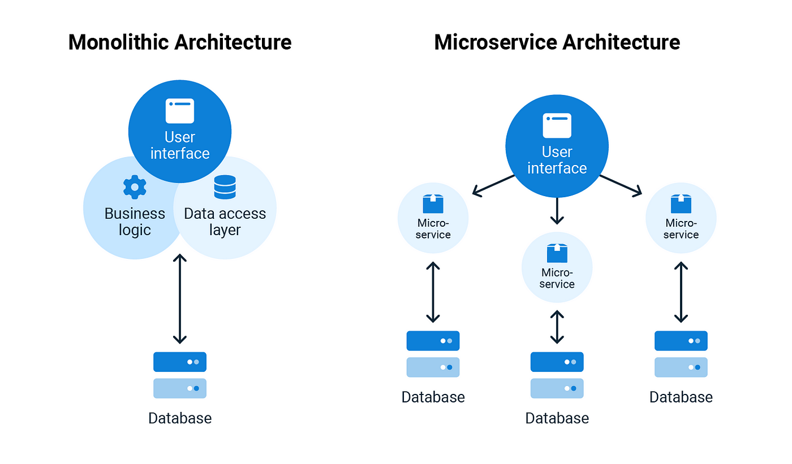
Benefits of transition from Monolithic to Microservices
The transition from monolithic applications to microservices can bring many benefits, including:
Improved scalability
Increased flexibility
Faster delivery time
Better resource utilization
Technology diversity
Notes:
Improved scalability: Microservices can be scaled individually, making it easier to handle changes in demand.
Increased flexibility: Microservices allow for a more flexible development process, as developers can work on individual components in parallel.
Faster delivery time: Microservices can be deployed faster as they are smaller and less complex than monolithic applications.
Better resource utilization: Microservices can be deployed on different infrastructure, leading to better resource utilization.
Technology diversity: Microservices can be built using different technologies and programming languages, allowing teams to choose the best tool for the job.

Slide 20
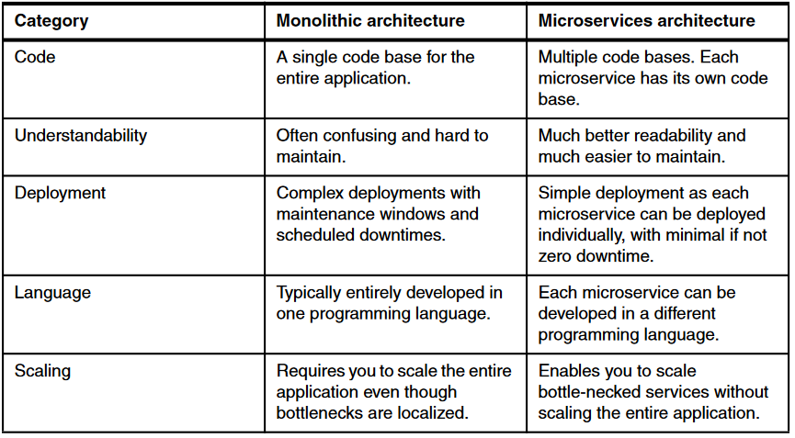
Monolithic vs Microservices

Slide 21
Microservices Architectures
Single-Service Microservices: Each microservice is responsible for a single, very specific task. This results in a large number of very small microservices.
Domain-Driven Microservices: The services are designed based on business capabilities and priorities. This approach emphasizes understanding the business’s needs and modeling the services accordingly.
Serverless Microservices: This is a new type of microservice where the service is hosted on a third-party server. This approach helps businesses to scale automatically and pay only for the resources they use.

Slide 23
5 Design Principles of MOA – Admin in mind
The benefits of an MOA can be significant, but they come with a price. You need to know a thing or two about microservice design to implement an MOA effectively—you can't make it up as you go along. A microservice application must follow these five principles:
Single concern
Discrete
Transportable
Carries its own data
Inherently ephemeral

Slide 24
10 Design Principles of MOA – Developers in Mind
For developing an optimal microservice architecture, you need to follow some design principles.
Independent and Autonomous/Self-governing services
API aggregation
Flexibility
Scalability
Constant monitoring
Failure Isolation/ Failure resilience
Realtime Load balancing
Inclusion of DevOps
Versioning
Availability

Slide 25
Microservice Languages & Technologies
The microservices architecture is a development methodology wherein you can fragment a single application into a series of smaller services, each executing in its own process and interacting with lightweight mechanisms.
The microservices are developed around business capabilities, which are independently deployable with automated deployment mechanism.
The microservices architecture needs a bare minimum of management of these services, built in different programming languages and employs different data storage technologies.

Slide 26
Criteria for Choosing a Technology for Microservices
With microservices, you can build a reliable platform to extend the business while taking advantage of diversity in languages. Of course, you can use different technologies or languages for different services, but it does not mean it is effective.
The microservices architecture comes with lots of operational overhead; hence adding a diverse programming language on top of that can exponentially raise that performance overhead.
To reduce that, you should standardize your microservices technology stack by choosing the programming language based on your business needs. Here are the criteria to evaluate the programming language for microservices development:
Highly observable
Support for automation
Consumer-first approach
Independent deployment
Modelled around business domain
Decentralization of components
Support for continuous integration

Slide 27
Design Patterns for Microservices
Microservices design patterns are fundamental to creating robust, scalable, and easily maintainable microservices-based applications.
The implementation of these patterns streamlines development and significantly improves the quality and maintainability of the resulting applications.
Recognizing and applying these patterns effectively can often be the difference between the success and failure of a microservices-based project. However, it's important to remember that each pattern comes with its own benefits and drawbacks.

Slide 28
Integration patterns
Integration patterns are a key aspect of a microservices architecture. They provide a roadmap to enable multiple microservices, possibly employing different protocols like REST or AMQP, to function in harmony.
These patterns aim to provide an efficient way for clients to interact with individual microservices without having to handle the intricacies of various protocols.
API Gateway Pattern
Aggregator Pattern
Proxy Pattern
Chained Microservice Pattern
Branch Pattern
Client-Side UI Composition Pattern

Slide 29
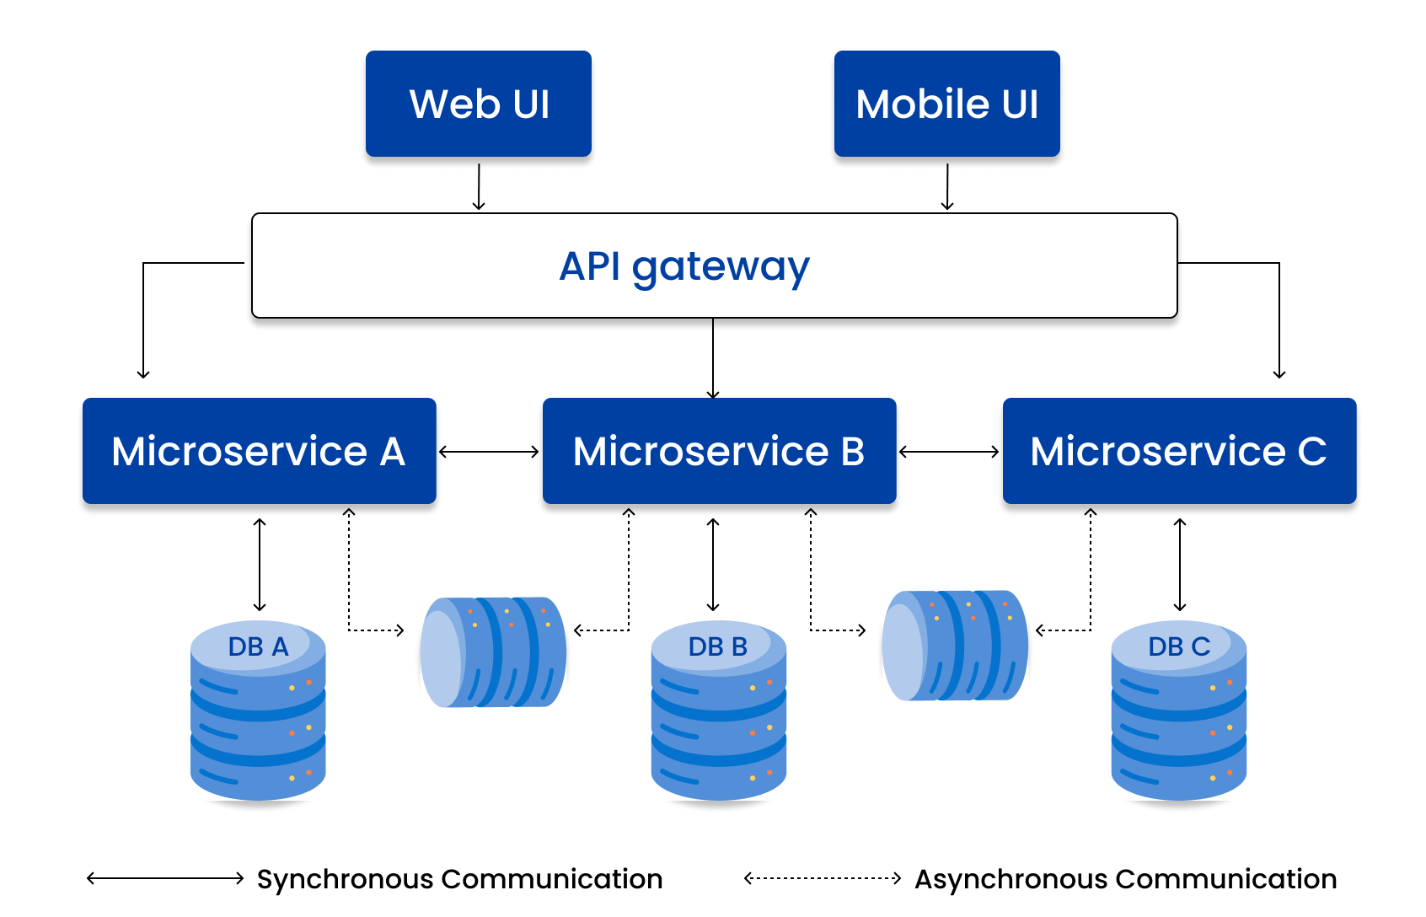
1. API Gateway Pattern
In this pattern, an API gateway serves as a reverse proxy that routes client requests to the relevant microservice, thereby minimizing the need for the client to interact with multiple microservices directly.
The API gateway also consolidates the results from different microservices, enhancing security by being the single point of contact for users.

Slide 30
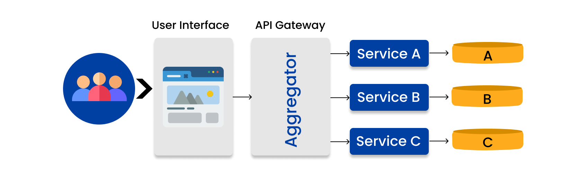
2. Aggregator Pattern
It is essential to consider how to coordinate the data generated by each service when decomposing business functionality into smaller logical units of code. This cannot be held accountable to the consumer.
The Aggregator pattern is a useful remedy for this problem. This demonstrates the potential for integrating data from multiple services to provide a comprehensive response to the customer.

Slide 31
3. Proxy Pattern
This pattern involves creating a proxy microservice that invokes other services based on business requirements, eliminating the need for an aggregator on the consumer end.

Slide 32
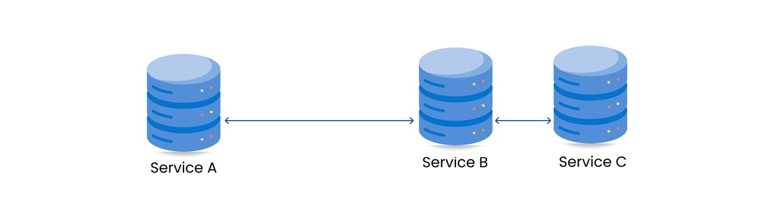
4. Chained Microservice Pattern
In cases where a single service has multiple dependencies, the Chained Microservice pattern can be used.
It enables a sequence of synchronous calls between microservices, ensuring a unified result in response to a given request.

Slide 33
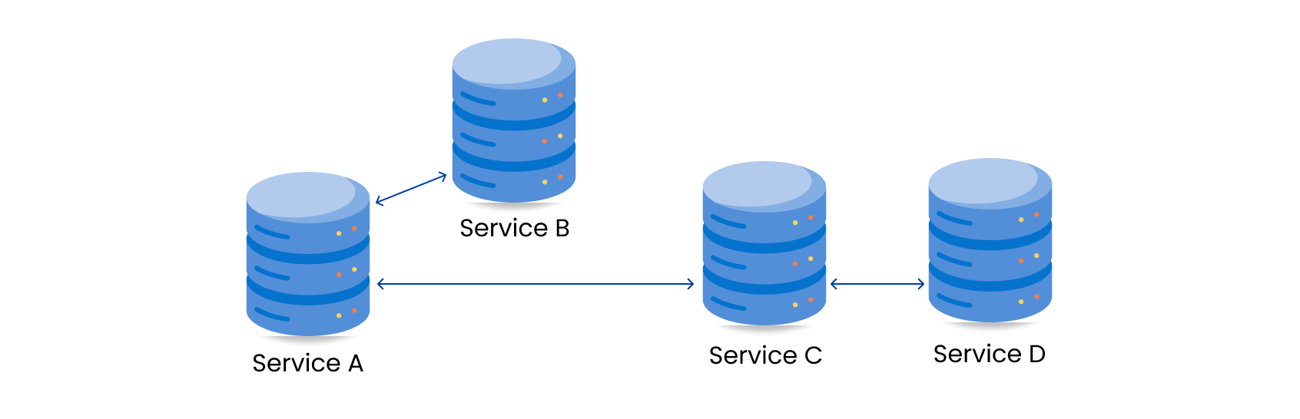
5. Branch Pattern
The Branch microservice pattern is a combination of the Aggregator and Chain design patterns.
It allows simultaneous processing of requests and responses from multiple microservices, making it an excellent fit for microservices that need to pull data from multiple sources.

Slide 34
6. Client-Side UI Composition Pattern
This pattern becomes essential when user experience services need to fetch data from various microservices.
Unlike monolithic architecture, where a single call from the user interface fetches data from a backend service, this pattern requires a user interface design segmented into different sections, with each section retrieving data from a distinct backend microservice.

Slide 35
Decomposing Monolith into Microservices
There are some patterns for decomposing the monolith to microservices:
Decompose by Business Capability
Decompose by Domain-Driven Design
Decompose by Transactions
Strangler fig Pattern
Service per team pattern

Slide 36
Decompose by Business Capability
The term "business capability" is a fundamental concept utilized in business architecture modeling.
A business capability is what a business does to generate value (for example, sales, customer service, or marketing). Typically, an organization has multiple business capabilities and these vary by sector or industry. Use this pattern if your team has enough insight into your organization's business units and you have subject matter experts (SMEs) for each business unit.
Value generation is a fundamental objective of business operations. A business capability typically aligns with a business object.

Slide 37
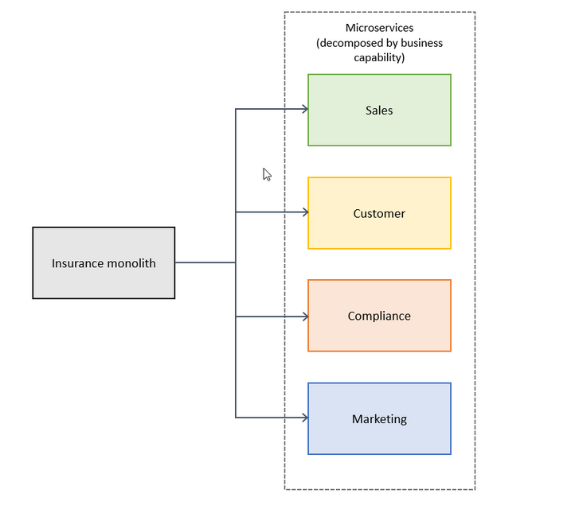
Decompose by Business Capability

Slide 38
Decompose by Domain-Driven Design
This task involves defining services that align with the subdomains of Domain-Driven Design (DDD).
Domain-Driven Design establishes the application's domain or problem space. Domains have subdomains. Each subdomain is associated with a distinct segment of the business. Subdomain classifications include:
Core - The enterprise's core is the software's most valuable part.
Supporting- "Supporting" activities or features are related to core business operations but do not provide a competitive advantage. These solutions can be internal or outsourced.
Generic- Generic solutions use readily available software and are not tailored to a specific organization.

Slide 39
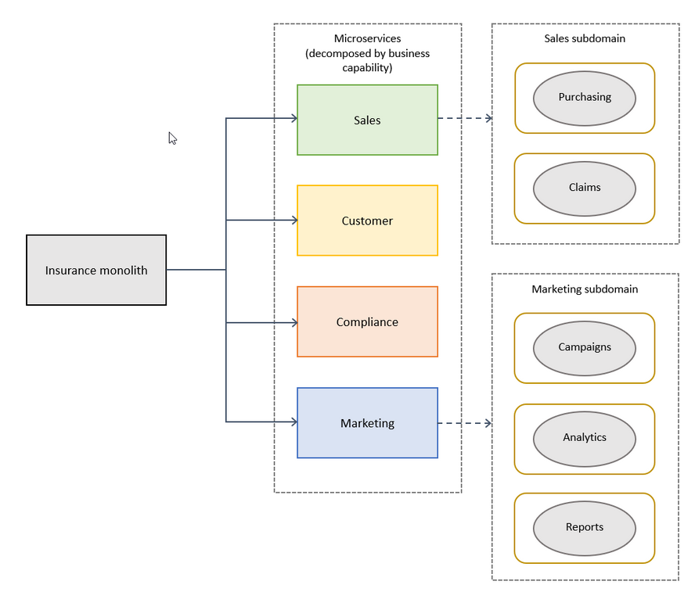
Decompose by Domain-Driven Design

Slide 40
Decompose by Transactions
In a distributed system, an application typically has to call multiple microservices to complete one business transaction.
To avoid latency issues or two-phase commit problems, you can group your microservices based on transactions.
This pattern is appropriate if you consider response times important and your different modules do not create a monolith after you package them.

Slide 41
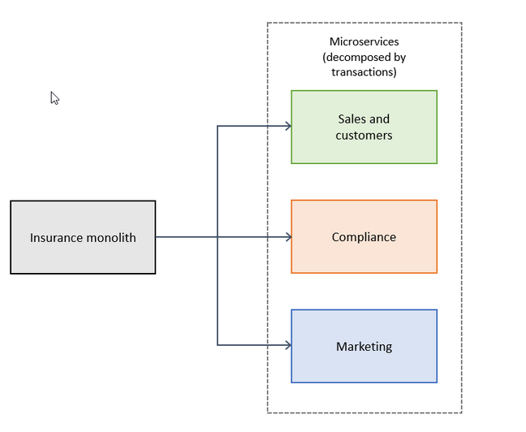
Decompose by Transactions

Slide 42
Strangler fig Pattern
The design patterns discussed so far in this guide apply to decomposing applications for greenfield projects.
What about brownfield projects that involve big, monolithic applications? Applying the previous design patterns to them will be difficult, because breaking them into smaller pieces while they’re being used actively is a big task.
The strangler fig pattern is a popular design pattern that was introduced by Martin Fowler, who was inspired by a certain type of fig that seeds itself in the upper branches of trees. The existing tree initially becomes a support structure for the new fig. The fig then sends its roots to the ground, gradually enveloping the original tree and leaving only the new, self-supporting fig in its place.
Notes:
This pattern is commonly used to incrementally transform a monolithic application into microservices by replacing a particular functionality with a new service. The goal is for the legacy and new, modernized versions to coexist. The new system is initially supported by, and wraps, the existing system. This support gives the new system time to grow and to potentially replace the old system entirely.

Slide 43
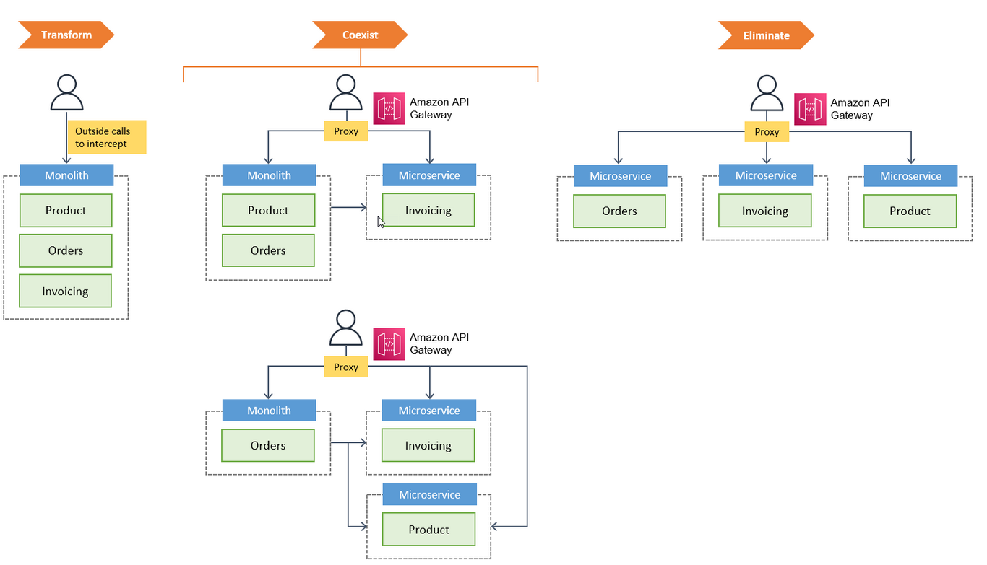
Strangler fig Pattern
Notes:
This pattern is commonly used to incrementally transform a monolithic application into microservices by replacing a particular functionality with a new service. The goal is for the legacy and new, modernized versions to coexist. The new system is initially supported by, and wraps, the existing system. This support gives the new system time to grow and to potentially replace the old system entirely.

Slide 44
Service per Team Pattern
Instead of decomposing monoliths by business capabilities or services, the service per team pattern breaks them down into microservices that are managed by individual teams.
Each team is responsible for a business capability and owns the capability's code base.
The team independently develops, tests, deploys, or scales its services, and primarily interacts with other teams to negotiate APIs.
We recommend that you assign each microservice to a single team. However, if the team is large enough, multiple subteams could own separate microservices within the same team structure.

Slide 45
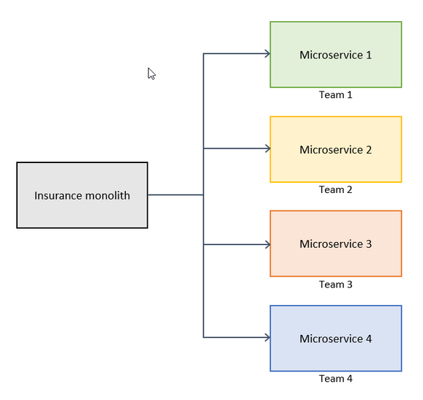
Service per Team Pattern

Slide 46
Inter-Service Communication
Inter-service communication is a pivotal concept in the microservices architecture. In a microservices architecture, an application is broken down into loosely coupled, independently deployable services.
These services need to communicate with each other to perform their tasks.
For Example: In the Spring framework, there are several ways to handle inter-service communication, ensuring seamless operation and interaction between microservices.

Slide 47
Types of Inter-Service Communication
Client and services can communicate through many different types of communication, each one targeting a different scenario and goals. Initially, those types of communications can be classified in two axes.
Synchronous protocol
Asynchronous protocol
Notes:
Synchronous protocol. HTTP is a synchronous protocol. The client sends a request and waits for a response from the service. That's independent of the client code execution that could be synchronous (thread is blocked) or asynchronous (thread isn't blocked, and the response will reach a callback eventually). The important point here is that the protocol (HTTP/HTTPS) is synchronous and the client code can only continue its task when it receives the HTTP server response.
Asynchronous protocol. Other protocols like AMQP (a protocol supported by many operating systems and cloud environments) use asynchronous messages. The client code or message sender usually doesn't wait for a response. It just sends the message as when sending a message to a RabbitMQ queue or any other message broker.

Slide 48
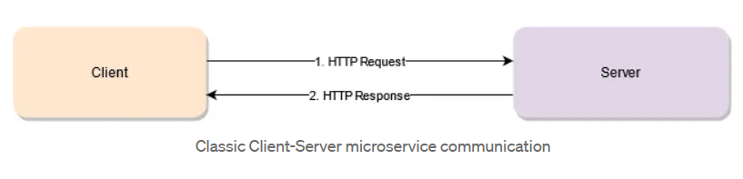
HTTP APIs
An HTTP API essentially means having your services send information back and forth like you would through the browser or through a desktop client like Postman.
It uses a client-server approach, which means the communication can only be started by the client. It is also a synchronous type of communication, meaning that once the communication has been initiated by the client, it won’t end until the server sends back the response.

Slide 49
HTTP APIs
Pros
Easy to implement
Quite Standard
Technology agnostic
Cons
Channel adds delay to business logic
Timeouts
Failures aren’t easy to solve
Notes:
Pros
Easy to implement. The HTTP protocol is not hard to implement and given all major programming languages already have native support for it, developers hardly need to worry about how it works internally. Its complexity is hidden and abstracted away by the libraries they use.
It can be quite standard. If on top of HTTP you add something like REST (properly implemented that is), then you’ve created a standard API that allows for any client to quickly learn how to communicate with your business logic.
Technology agnostic. Since HTTP acts as the data-transfer channel between client and server, the technology used to create either of them is irrelevant. You can code your server in Node.js and have the client (or the other services) coded in JAVA or C# for all they care. As long as they follow the same HTTP protocol they’ll be able to communicate with each other.
Cons
The channel adds a delay to the business logic. HTTP it very reliable, but that’s because as part of the protocol, there are a few steps that make sure data is correctly sent through the channel. However, this protocol also adds latency to the communication (extra steps mean extra time). So consider a scenario where 3 or more microservices need to send data between each other until the last one finishes. In other words, having A send data to B so it can send data to C, to only then start sending the responses back. On top of each service’s time, you have to add the latency added by the 3 client-server channels opened between them.
Timeouts. Although you can configure the timeout time in most scenarios, HTTP by default will cause the client to close the connection if the server is taking too long. How long is “too long”? That depends on the configuration and the service you’re using, however it’ll be there. This adds an extra constraint to your logic: it needs to be fast, otherwise it will fail.
Failures aren’t easy to solve. It’s not impossible to work around a server failure, but you need to have extra infrastructure in place to solve it. By default the client-server paradigm will not notify the client if the server is down. The client will realize that too late: when they try to reach the server. As I said, there are ways to mitigate this, for example, by using load balancers or API gateways, but that’s extra work that needs to go on top of the client-server communication to make it reliable.

Slide 50
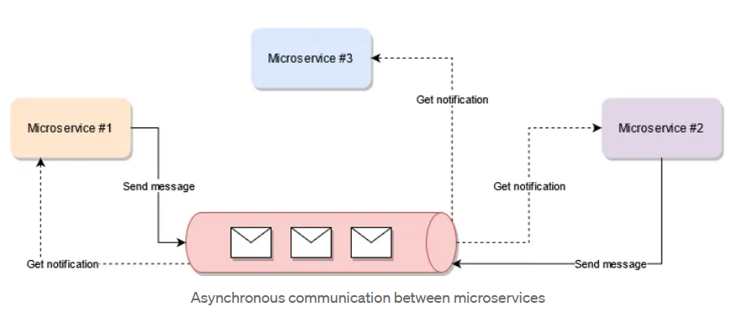
Asynchronous Messaging
This pattern consists of having a message broker between the producer of the message and the receiving end.
This is definitely one of my favorite ways of communicating multiple services with each other, especially when there is a real need to horizontally scale the processing power of the platform.
Notes:
This pattern usually requires a message broker to be added into the mix, thus bringing a bit of extra complexity to the table. However, the benefits gained more than makeup for that.

Slide 51
Asynchronous Messaging
Pros
Easy to scale
Easy to add new services
Easier retry mechanics
Event-driven
Cons
Debugging gets a bit harder
There is no clear direct response
The broker becomes a single point of failure
Notes:
Pros
Easy to scale. One of the major problems of direct communication between client and server is that for the client to be able to send messages the server needs to have free processing power. But that’s limited by the amount of parallel processing a single service can perform. If the client requires more data to be sent then the service needs to grow and have more processing power. This sometimes is solved by scaling the infrastructure where the service is deployed, giving it a better processor or more memory, however this also has a limitation, since there is so much you can pay for before it becomes unreasonable. Instead, you can keep using lower specs infra and have multiples copies working in parallel. The message broker can distribute the received messages to more than one target service. Thus your copies can either all receive the same data or different messages depending on your particular needs.
Easy to add new services. Hooking up new services to this workflow is as simple as creating a new service and subscribing to the type of message you’d like to receive. The producer doesn’t need to be aware of it, it just needs to understand what kind of message it needs to send. That’s all.
Easier retry mechanics. When the message broker allows for it, if the delivery of the message fails due to the server worker being down, the broker can keep trying automatically without us having to write special logic.
Event-driven. This pattern allows you to create event-driven architectures, which can be some of the most efficient ways of having microservices interact with each other. Instead of having a single service blocked because it’s waiting for a synchronous response, or even worse, having it constantly poll a storage medium waiting for its response, you can code your services so that they get notified once their data is ready. While that happens, they can be working on something else (like the next incoming request). This architecture allows for faster data processing, more efficient use of resources and overall better communication experience.
Cons
Debugging gets a bit harder. Since there is no clear data flow now and messages get processed as soon as they can, debugging the data flow and the path your payload takes can become a nightmare. This is why it’s usually a good idea to generate a unique ID when the message is received, so that you can track the path it takes inside your internal architecture through the logs.
There is no clear direct response. Given the asynchronous nature of this pattern, once a request is received from a client, the only potential response is “OK, received, I’ll let you know once it’s ready”. You could also validate the schema of the request sending a 400 error (if it’s an invalid request). The point being, the output returned by the logic you’re executing is not directly accessible to the client, instead it needs to be requested separately. As an alternative, the client can also subscribe to the message broker waiting for response-type messages. This way it gets notified immediately once the response message arrives.
The broker becomes a single point of failure. If you don’t configure the message broker properly, it can become a problem for your architecture. Instead of suffering from unstable services that you wrote, you’re forced to maintain a message broker you barely know how to use.

Slide 52
Direct Socket Communication
At a first glance, the socket-based communication looks a lot like the client-server pattern implemented in HTTP, however, if you look closely there are some differences:
For starters, the protocol is a lot simpler, which means a lot faster as well. Granted, if you want it to be reliable you need to code a lot more on your part to make it so, however, the inherent latency added by HTTP is gone here.
The communication can be started by any actor, not only the client. Through sockets, once you have your channel open, it’ll stay that way until you close it. Think about it as an ongoing phone call, anyone can start the conversation, not only the caller.
Notes:
Socket-based communication is a very efficient way of having your services talk to each other. For instance, Redis uses this method when deployed in a cluster configuration to automatically detect failing nodes and remove them from the cluster. This can be done because the communication is fast and cheap (meaning there is barely any extra latency involved and uses very little network resources).

Slide 53
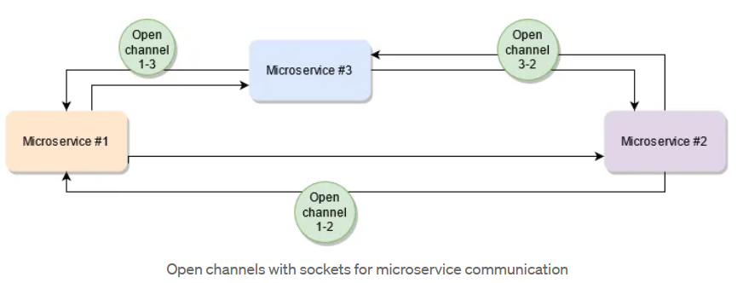
Direct Socket Communication

Slide 54
Direct Socket Communication
Pros
It’s very lightweight
Allows for a very optimized communication process
Cons
No real standards in place
Easy to overload the receiving end
Notes:
Cons
No real standards in place. When compared with HTTP, the socket-based communication seems a bit messy because there aren’t any structured standards such as SOAP & REST for HTTP. So it’s really up for the implementing party to define how that structure looks like. This in turn makes it a bit harder for new clients to be created and implemented. However, if you’re doing this so that only your own services can interact with each other, you’re essentially implementing the protocol you defined.
Easy to overload the receiving end. If one of the services starts producing too many messages for the other to process, you might end up overwhelming the second process and crashing it. This is what the previous pattern solved, by the way. Here you have a very small delay between sending and receiving the message, which means the throughput can be higher, but that also means the receiving service will have to process everything fast enough.
Pros
It’s very lightweight. Implementing basic socket communication requires very little effort and setup. This, of course, depends on the language you’re using, but some of them, such as Node.js with Socket.io allow you to communicate 2 services with but a few lines of code.
Allows for a very optimized communication process. Since you have a constant open channel between the two services, they’re both able to react to incoming messages the moment they arrive. It’s not like you’re pooling a database asking for new messages, this is a reactive approach, which means you can’t really get faster than this.

Slide 55
Lightweight Events
This pattern mixes the first two on this list. On one side, it provides a way of having multiple services communicate with each other through a message bus, thus allowing for asynchronous communication.
And on the other side, since it only sends very lightweight payloads through that channel, it requires services to hydrate that payload with extra information through a REST call to the corresponding service.
Notes:
This communication pattern can come very handy when you’re aiming to have the network traffic kept under control as much as possible, or when the message queue has packet-size limitations. In those cases, it’s best to keep things as simple as possible and then request the extra information only when required.

Slide 56
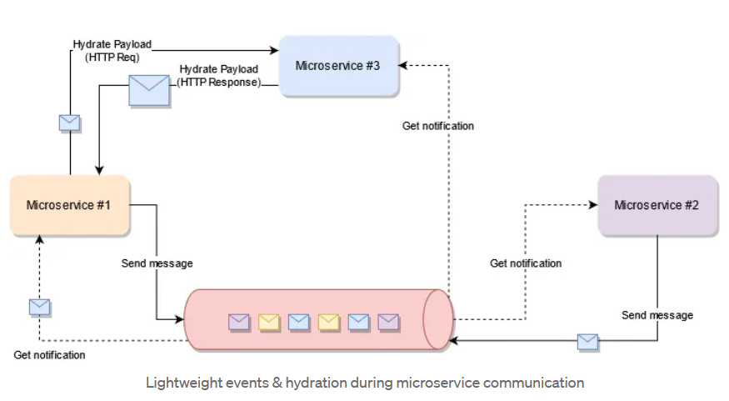
Lightweight Events
Notes:
This communication pattern can come very handy when you’re aiming to have the network traffic kept under control as much as possible, or when the message queue has packet-size limitations. In those cases, it’s best to keep things as simple as possible and then request the extra information only when required.

Slide 57
Lightweight Events
Pros
The best of both worlds
Focused on optimizing the most common scenario
Basic buffer
Cons
You might end up with too many API requests
Double communication interface
Notes:
Cons
No real standards in place. When compared with HTTP, the socket-based communication seems a bit messy because there aren’t any structured standards such as SOAP & REST for HTTP. So it’s really up for the implementing party to define how that structure looks like. This in turn makes it a bit harder for new clients to be created and implemented. However, if you’re doing this so that only your own services can interact with each other, you’re essentially implementing the protocol you defined.
Easy to overload the receiving end. If one of the services starts producing too many messages for the other to process, you might end up overwhelming the second process and crashing it. This is what the previous pattern solved, by the way. Here you have a very small delay between sending and receiving the message, which means the throughput can be higher, but that also means the receiving service will have to process everything fast enough.
Pros
It’s very lightweight. Implementing basic socket communication requires very little effort and setup. This, of course, depends on the language you’re using, but some of them, such as Node.js with Socket.io allow you to communicate 2 services with but a few lines of code.
Allows for a very optimized communication process. Since you have a constant open channel between the two services, they’re both able to react to incoming messages the moment they arrive. It’s not like you’re pooling a database asking for new messages, this is a reactive approach, which means you can’t really get faster than this.

